Slide 1
Gifted Education Section, CDI, EDB Learning and Teaching Resources for Linguistically Gifted/ More Able Students (English Language)
Pet keeping and adoption
(Junior secondary levels)
September 2021

Slide 2
Topic: | Pet keeping and adoption
Learning Objectives: | To understand the current situation of animal abandonment and adoption in Hong Kong; To nurture positive attitudes and values of responsibility, empathy and care for pets; To learn the features of a speech; To enhance high-order thinking skills and creativity through a public speaking activity; and To develop reading, writing and speaking skills.

Slide 3
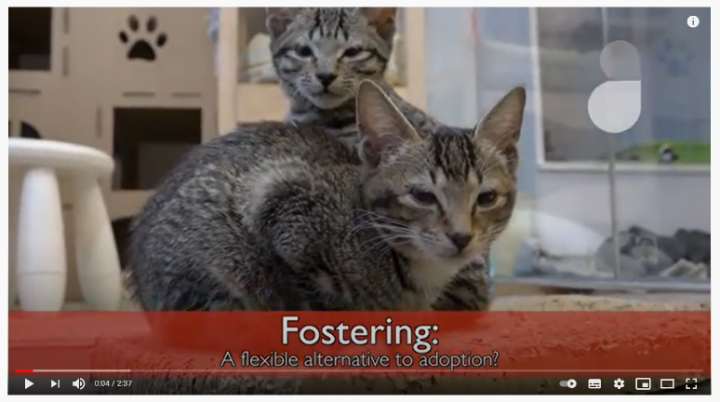
Part 1: Pre-lesson learning
What you need to know about fostering animals in Hong Kong (video from Young Post)
Watch the video here:
https://youtu.be/u9JMtdi2R0E
Answer the following questions.
1. How did LAP Lifelong Animal Protection get the cats?
A. People who emigrate leave their cats behind
B. Retired breeding cats
C. Cats that were caught and kept in kennels run by the government
D. All of the above
2. Why does Sheila emphasise that each cat or dog is an individual and
they all have a different story?

Slide 4
3. Do you agree with Sheila that pet fostering is more flexible than
adoption? Give two reasons.
4. According to Sheila, which of the following people would be a good
cat foster parent?
5. In your opinion, pet fostering and adoption, which one is more
important in Hong Kong?
Share your views in no less than 30 words.
A. | Ms CHAN is a solicitor. She lives in a 2-storey house in the Mid-levels. There would be lots of space for cats to play and exercise. She spends most of her time working in her office and doesn't return home until 10 p.m. every night.
B. | Mrs WONG is a housewife living in a small apartment of 200 square feet. She used to have a cat which passed away because of its old age a year ago. She loves spending time with cats and considers cats as her best pals.
C. | Mr HO runs a pet shop and knows much about cats. He has 5 cats at home. His hobbies are cooking and pet grooming
Click here for answers

Slide 5
Animal-friendly measures
The government of Hong Kong has been implementing
animal-friendly measures in Hong Kong to ensure that animals and people co-exist in a harmonious way. Read the information notes from Research Office of Legislative Council Secretariat to know more about Animal-friendly measures in selected places:
https://www.legco.gov.hk/research-publications/english/1819in20-animal-friendly-measures-in-selected-places-20190827-e.pdf
What else can the government do to make
Hong Kong an animal-friendly place?
Share your ideas with your classmates.
Food for
thought

Slide 6
Part 2: Reading (Worksheet A)
Read Text 1 and answer the following questions.
1. Find a word that means the same as “surrendered”.
2. What are the two criteria for animals to pass the selection for re-homing?
3. Why do you think AFCD encourage people to adopt through their partnering AWOs?
4. What would the partnering AWOs do to prevent over-population of animals?
Click here for answers

Slide 7
Read Text 2 and answer the following questions.
5. According to Text 2, are the following statements True (T), False (F) or Not Given (NG)?
6. According to the report, most of the dogs/ cats kept by households are gifts from relatives/ friends. Is it a good practice? Why or why not?
7. What advice would you give to a friend who would like to give up his puppy? Answer in no less than 30 words.
Statements | T | F | NG
(i) People prefer keeping dogs to cats as pets in Hong Kong.
(ii) Most people give up their pets because of the pets’ behavioural problems.
(iii) Some pet shops take unwanted pets.
Click here for answers

Slide 8
Read Text 3 and answer the following questions.
8. What does the expression “the light at the end of the tunnel”
mean? In Text 3, what does it refer to?
9. Find two words in paragraph 1 which tell you that the animals found at Stray Wonderland were in dire conditions.
10. Why is the word “naturally” being highlighted in paragraph 3?
11. Find two metaphors used in Text 3.
12. What does “pawrents” (line 23) mean?
13. What is the tone of Carmen in lines 20-21?
A. bitter
B. amusing
C. reflective
D. annoying
Click here for answers

Slide 9
Questions below are not based on Texts 1 to 3, but serve to extend and enrich students’ learning on the selected topic.
Suggest two effective ways to stop pet abandonment in Hong Kong. Give reasons to support your answers.
Lots of devoted pet owners pamper their pets with professional pet grooming. Do you think trimming or cutting whiskers of cats and cutting off or surgically shaping dogs' ears or tails an act of love?
Should warm and attractive pets like cats and dogs have more rights than rare pets like snakes and lizards? Why?

Slide 10
Part 3: Vocabulary
Twenty vocabulary related to animal protection are selected for you. Make use of the dictionary web sites on Slide 21 to learn more about the pronunciation, definition and usage of words :
Vocabulary
Abandon (v.) | Allergic (adj.) | Breed (v./ n.) | Cage (n.)
Canine (n.) | Euthanasia (n.) | Fetch (v.) | Foster home (n.)
Grooming (n.) | Inhumane (adj.) | Kennel (n.) | Leash (n.)
Malnourished (adj.) | Rescue (v./ n.) | Shelter (n.) | Surrender (v.)
Stray animals (n.) | Traumatised (adj.) | Trap, neuter, return (TNR) | Veterinarian (n.)

Slide 11
Part 4: Language features
Please refer to Worksheet B.
A speech is a formal talk given usually to a large number of people on a special occasion. Generally, speeches serve four purposes:
To inform
To persuade
To inspire
To entertain

Slide 12
Tips to prepare for your speech
1. Introduce yourself
2. Make an attractive opening statement
A rhetorical question
A surprise
A quote
3. Main body
Begin with a topic sentence
Support your ideas with elaboration/ evidences (e.g. statistics)
Use personal experiences/ emotive or figurative languages/ repetitions/ rules of three to illustrate or emphasise your points (more examples found in Worksheet B)
4. Closing/ conclusion

Slide 13
An example of a speech
Speech by Mr Raymond HC WONG, the then Permanent Secretary for Education, at the Hong Kong Annual Gifted Education Conference 2010 on 20th May 2010. Honoured Guests, Principals and Teachers, Good morning. We are here today to share the good practices in developing curriculum and instruction for the gifted. I am delighted to welcome all our committed educators, guests, speakers and participants, to exchange insightful experiences and ideas in nurturing our young potential leaders and innovators of tomorrow. Like all learners, the gifted need frequent opportunities to transfer their knowledge and understanding from the textbook to real-world applications. They need a secure and challenging learning environment to thrive. They also need to learn beyond the classroom. This open and conducive learning culture demands the skilful teacher’s well-grounded
Greet and welcome your audiences
Begin your speech with an introduction that establishes the purposes of your speech, what you will be talking about to set the expectation of audience

Slide 14
decisions to cater for the high-attaining students’ intellectual and affective needs. Furthermore, gifted students need to learn to make connections across subjects. They need to be supported in taking learning initiatives, with their interests and learning styles valued and addressed. They need to learn to be open to others’ ideas and opinions. They need better exposure through enriched learning experiences with suitable challenges. All these needs should be well catered for when designing the curriculum and instruction for the gifted. This is never an easy mission to accomplish. Nonetheless, this is the mission we are undertaking concertedly every day. ‘Nurturing gifts: Enriching learning experiences’, the theme of this year’s annual gifted education conference, addresses a significant concern of teachers of gifted students. We are striving for excellence in education to do everything we can to develop and stretch our gifted students’ abilities to their full potential. Their learning should never be confined by a syllabus. We have to lift the ceiling. We need to foster
1. Organise your speech into three to five main points according to the importance. Begin each paragraph with a topic sentence and support your ideas with elaboration/ evidence.
2. Effective use of repetition (e.g. They need…) help make your speech more persuasive.
Use of figurative language

Slide 15
interdisciplinary learning. We are aiming to guide our gifted students to the highest form of success which will not come easily but which will bring about the most rewarding achievements they value in life. Later today, renowned academics and practitioners in gifted education will convene the sessions on enriching the learning experiences of the gifted. I wish you all a fruitful and inspiring exchange. May I congratulate all those who have worked hard to make this conference a success. My gratitude also goes to the Hong Kong Academy for Gifted Education for co-organising the conference with us, and the InnoCentre for providing the venue and other assistance. I would like to conclude by quoting JF Kennedy : “There are risks and costs to action. But they are far less than the long range risks of comfortable inaction”. Thank you.
Closing/ conclusion: summarise your ideas or restate your main purpose. You may also extend your wishes and gratitude to the audience.
The use of quote to give a more concise, memorable phrasing for an idea
Reference:
https://www.edb.gov.hk/en/about-edb/press/speeches/psed/20100520160531.html

Slide 16
Part 5: Writing Task (A speech) Choose ONE topic and write an 1 to 2-minute speech.
Core
Five things to know before getting a pet
Owning a pet is a privilege, but the benefits of pet ownership come with responsibilities no matter if the new member of your family is furry, scaly, big or small. Write a short speech to give five essential tips people need to know before having any pet.

Slide 17
Do you want to keep a pet?
Let’s try the extended task below.
EXTENSION
Love is home: what makes me a good pet owner
Having the right pet can be both an educational and enriching experience for teenagers. Write a short speech to convince your parents to allow you to have a pet. Tell them the kind of pet you wish to have and what personal qualities of yours make you a good pet owner.

Slide 18
Want some challenges and think more about
pet-keeping around the world?
Let’s try the challenging task below.
CHALLENGE
The beauty of adoption during the epidemic
According to the Society for the Prevention of Cruelty to Animals (SPCA), the benefit of having a companion animal is tangible. It is observed that there has been an increase in people interested in fostering and adopting animals around the world since the outbreak of COVID-19.
Why is there a surge of people adopting a pet and how does pet adoption benefits people amid the epidemic? Share your views.

Slide 19
A public speaking challenge!
So you’ve written a speech, but the challenge doesn’t end here!
Record your speech and upload it to any Learning Management System adopted by your class so your friends and teachers can hear it.
Pay extra attention to your volume, tone, pace, facial expressions and gestures!

Slide 20
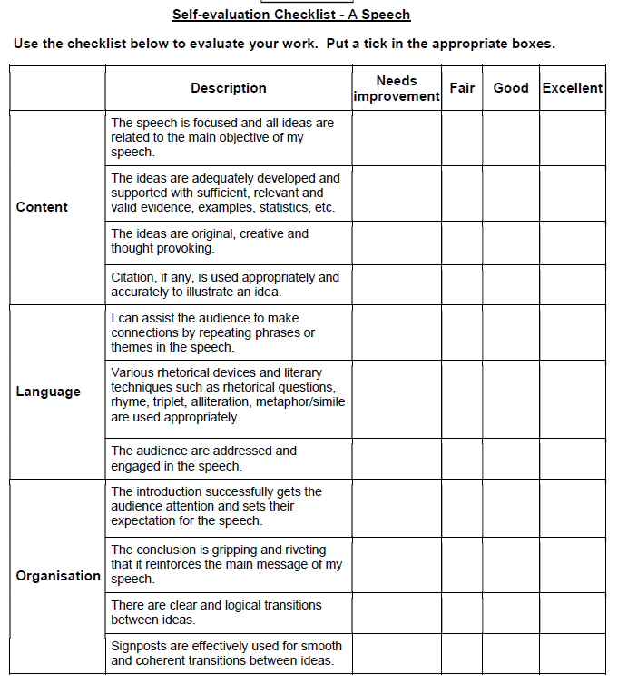
Part 5: Self-evaluation
Use the self-evaluation checklist (Worksheet C) to evaluate your speech.
Make changes to your speech if necessary

Slide 21
WORD WHIZ
Visit the following dictionary web sites (in alphabetical order) to learn more about the pronunciation, definition and usage of words:
1. Cambridge Dictionary
https://dictionary.cambridge.org/
2. Oxford Learner’s Dictionaries
https://www.oxfordlearnersdictionaries.com/

Slide 22
Reading Beyond Boundaries
To gain some new knowledge from online encyclopaedia or to immerse yourself in the magical world of fiction, make good use of the electronic resources offered by the Hong Kong Public Libraries!
Link: https://hkpl.overdrive.com

Slide 23
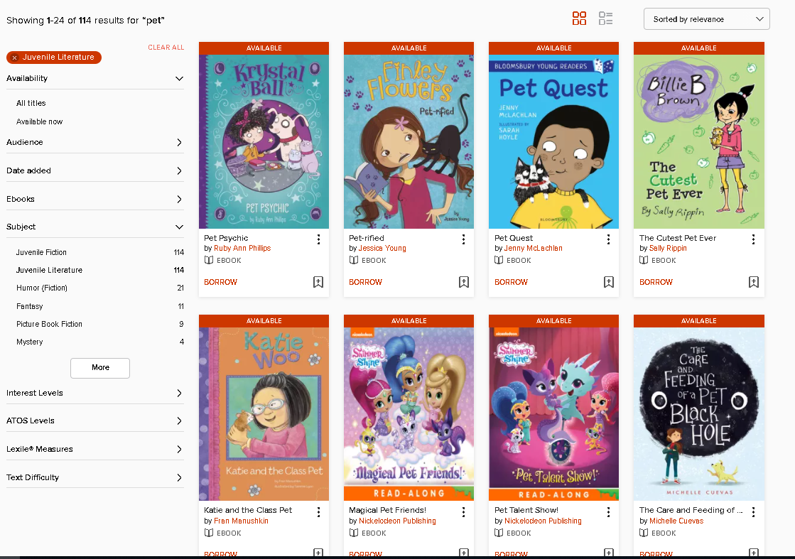
Hong Kong
Public
Libraries -
E-book collection
Non-fiction
Knowing more about animal welfare!
Fiction
Going on adventures with your pets!

Slide 24
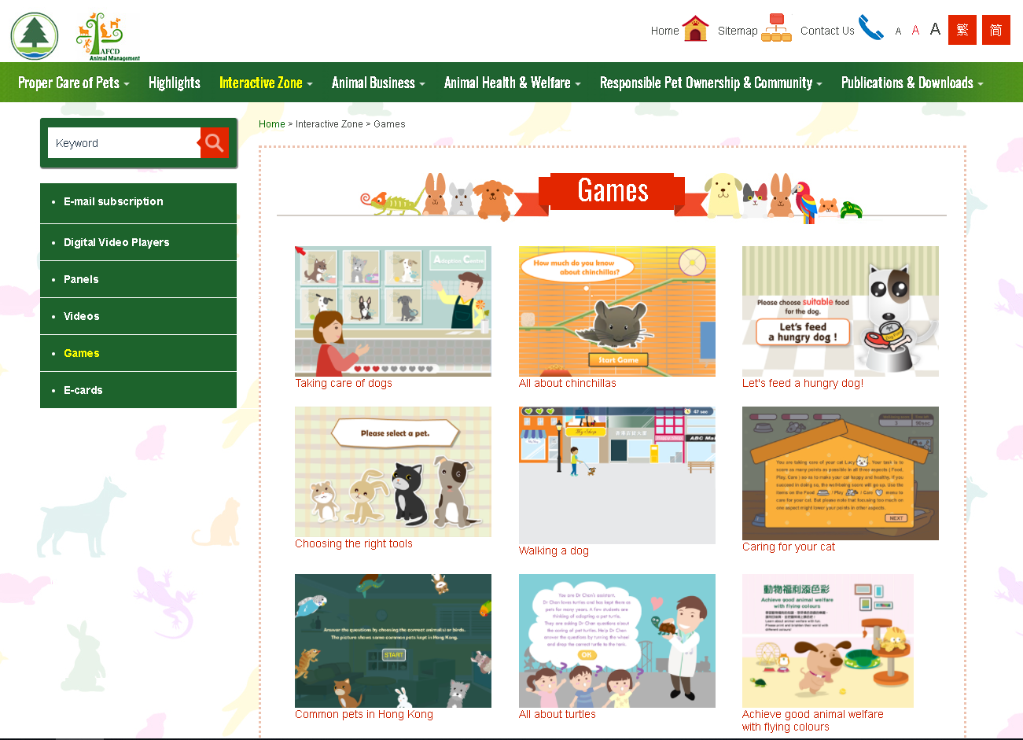
Interactive games
Visit the website of Agriculture, Fisheries and Conservation Department to learn more about keeping pets in Hong Kong.
Link: https://www.pets.gov.hk/english/multimedia_zone/games/games_index.html

Slide 25
Suggested Answers
Part 1: Pre-lesson learning (Slide 3)
1. All of the above
2. Students’ own answers / Each cat or dog is different, they have different needs for caring. Some take shorter time to adapt to new environment; while others need more time. They also bond with people differently.
Students’ own answers
Mrs WONG
Students’ own answers
Back to
Slide 5

Slide 26
Suggested Answers
Part 2: Reading – Text 1 (Slide 6)
abandoned
They should be healthy and have a nice temperament.
It’s because there are proper adoption process to follow.
They would neuter the animals before putting them up for adoption.
Back to
Slide 7

Slide 27
Suggested Answers
Part 2: Reading – Text 2 (Slide 7)
5.
No, (suggested answers: it is because the owners may not like the cats/ dogs given as gifts/ the owners may not have the financial ability, time or commitment to care for the pet)
Students’ own answers
√
√
√
Back to
Slide 8

Slide 28
Suggested Answers
Part 2: Reading – Text 3 (Slide 8)
It is a sign of improvement in a situation that has been bad for a long time/ It means hope amid despair. In Text 3, it refers to Carmen and Vincent.
Malnourished and carcasses
It is because the writer wants to indicate emphasis that February’s reaction after arriving at her new home is actually not natural.
“Princess” and “gangster”
Parents for paws/ animals/ pets
B
Back to
Slide 9

Slide 29
References
Agriculture, Fisheries and Conservation Department - Animal Management. https://www.pets.gov.hk/english/index.html
Census and Statistics Department. (2019). Thematic Household Survey Report No. 66. https://www.censtatd.gov.hk/en/data/stat_report/product/C0000034/att/B11302662019XXXXB0100.pdf
Education Bureau. (2010). Speech at the Hong Kong Annual Gifted Education Conference 2010. https://www.edb.gov.hk/en/about-edb/press/speeches/psed/20100520160531.html
Edpuzzle. https://edpuzzle.com/
Padlet. https://padlet.com/
Quizlet. https://quizlet.com/
Research Office of Legislative Council Secretariat. (2019). Information Note: Animal-friendly measures in selected places. https://www.legco.gov.hk/research-publications/english/1819in20-animal-friendly-measures-in-selected-places-20190827-e.pdf
The Society for the Prevention of Cruelty to Animals
https://main.spca.org.hk
Young Post. (2018, Jan 5). What you need to know about fostering animals in Hong Kong [Video]. YouTube. https://youtu.be/u9JMtdi2R0E

